Slide 1

Nrega AnalySIs
By : Nithya dharshini

Slide 2
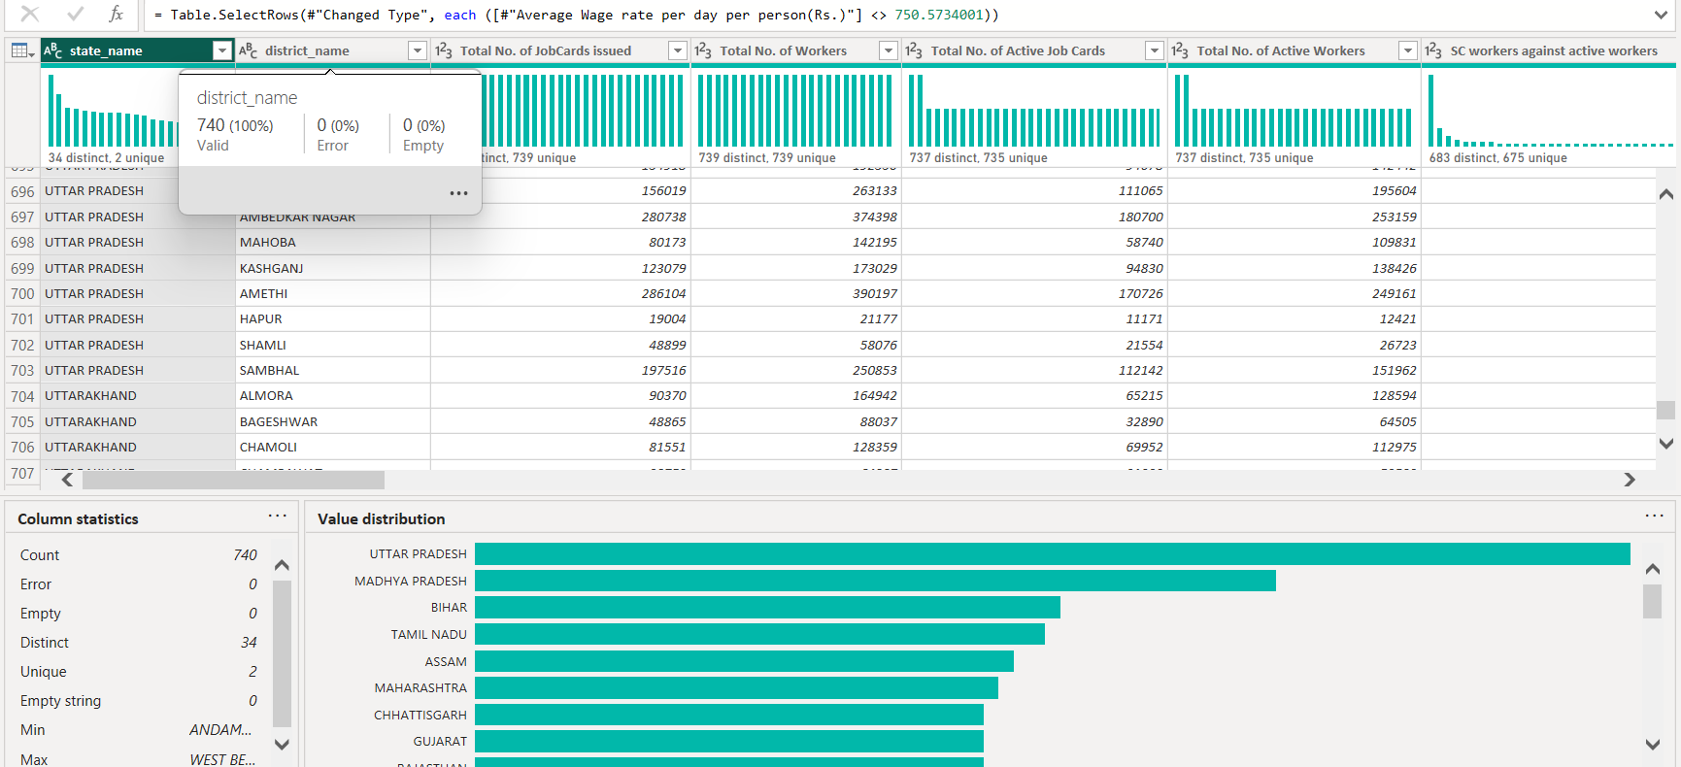
Data pre-processing
Using power query we check for missing values, if the datatype is correct for each field and use column distribution and column profile to check for incorrect data entry

Slide 3
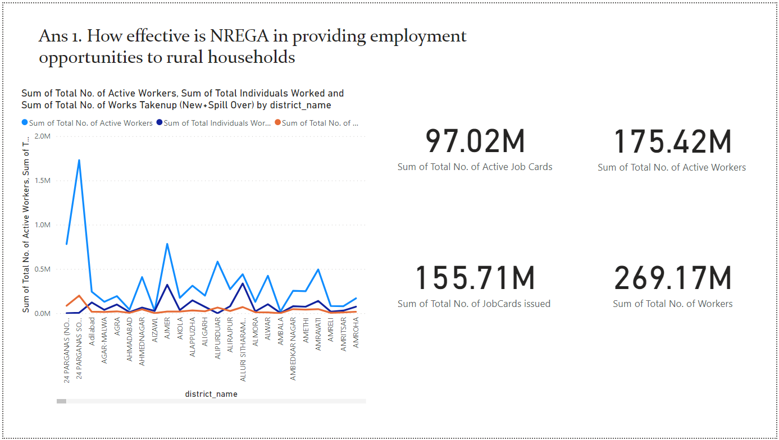
INSIGHTS
By analysing the number of active workers, total number of individuals worked and work taken per district we can see how effective NREGA is in providing employment opportunities
We can also see that there have been 97.02M total active job cards, 175.42M active workers, 155.71M total number of jobcards issued and 269.17M total number of workers who benefitted from NREGA.
Hence we can conclude by saying that NREGA has been greatly effective at providing employment opportunities.

Slide 4
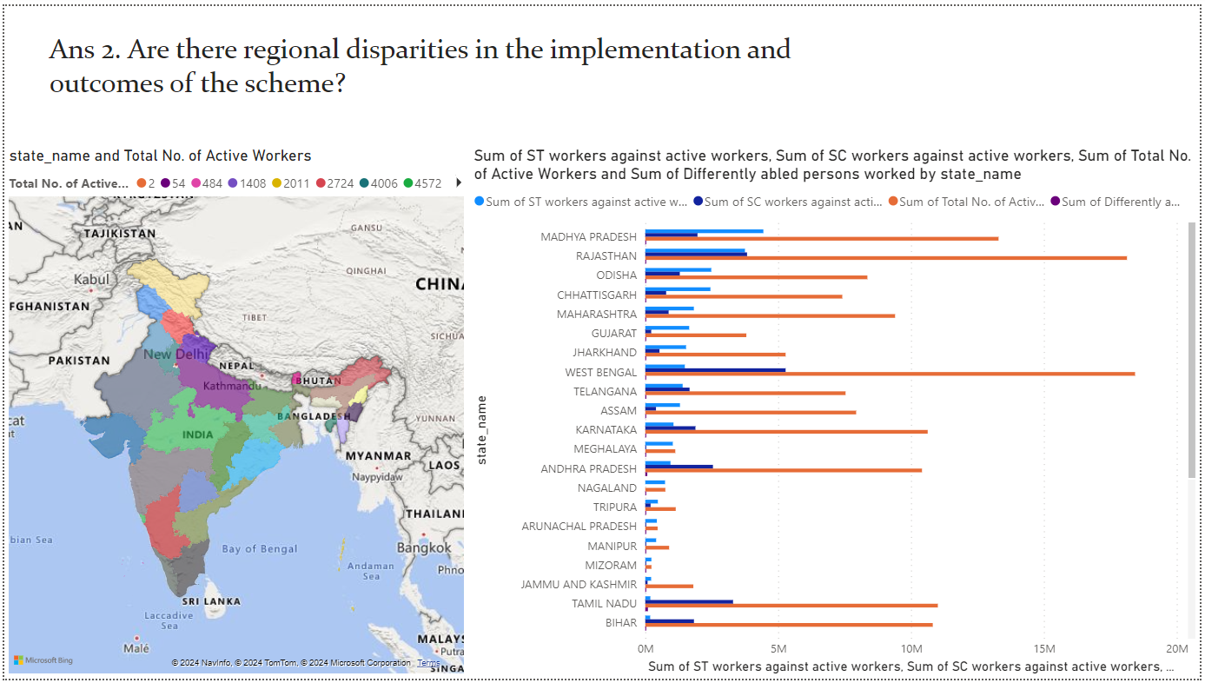
INSIGHTS
From the clustered bar chart, we can see how the number of workers in each region greatly differ.
Hence, we can say that there have been regional disparities in the implementation and outcomes of the scheme.

Slide 5
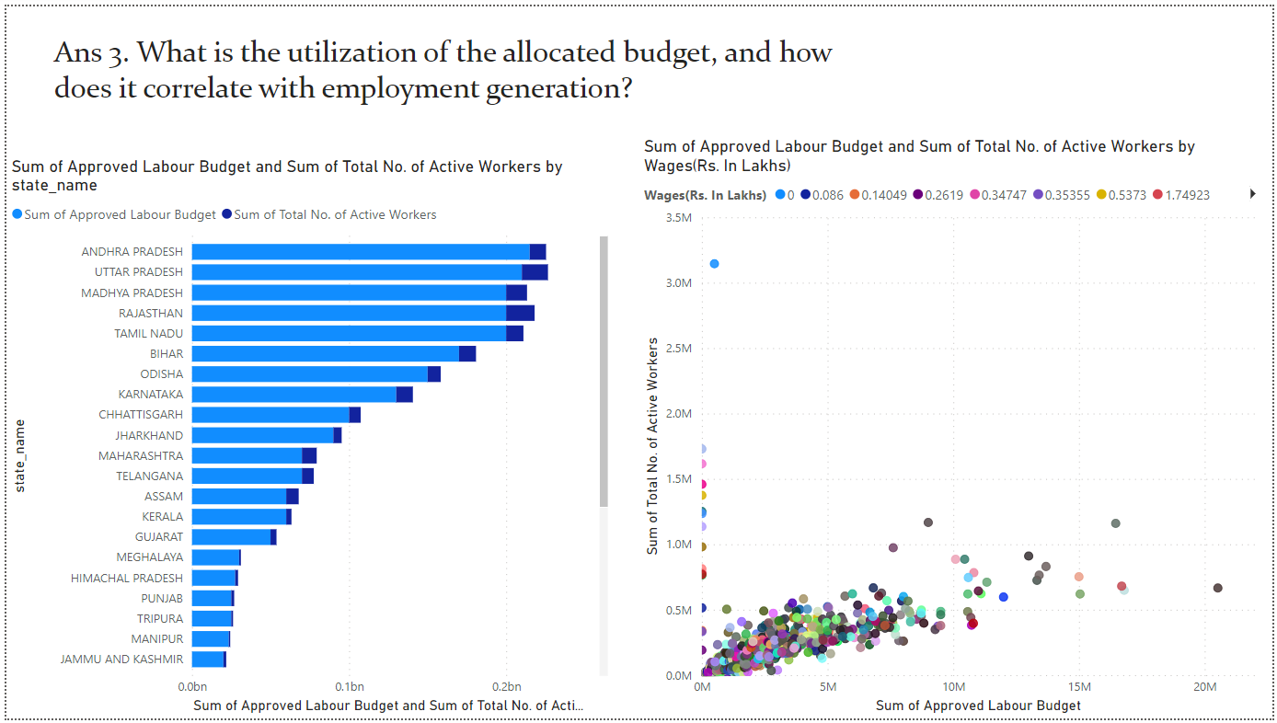
INSIGHTS
By seeing their correlation using these visual tools we can say that regardless of the budget allocated, there in not much difference in the employment generated. Even though, they are directly related, it’s more or less the same throughout.

Slide 6
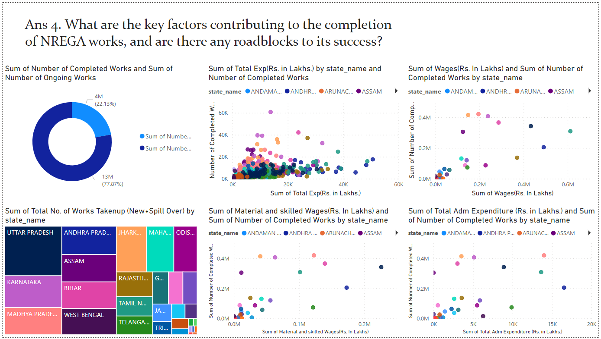
INSIGHTS
We have made various scatter plot comparisons.
We can see that Total Expenditure, Wages, Material and Skilled wages and Administrative expenditure , all these factors significantly contribute to the completion of NREGA works.
We can say that the roadblock to success is that the ratio of completed works to ongoing works is very less, hence the process should speed up.

Slide 7
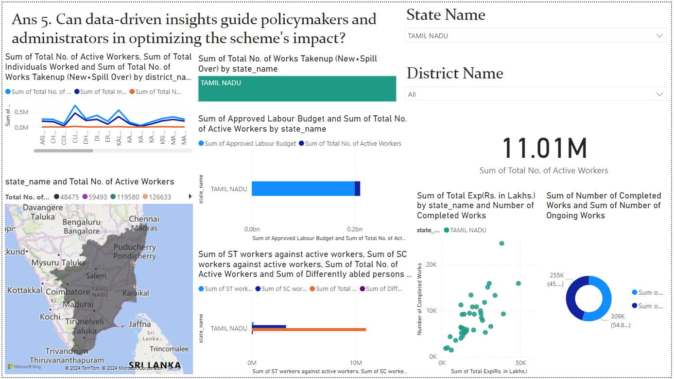
INSIGHTS
Yes, By using Slicer dropdown options, we can filter out all these previous visualizations that will help policymakers and administrators in analysing and optimizing the scheme’s impact.

Slide 8
Thank you!

